Slide 1
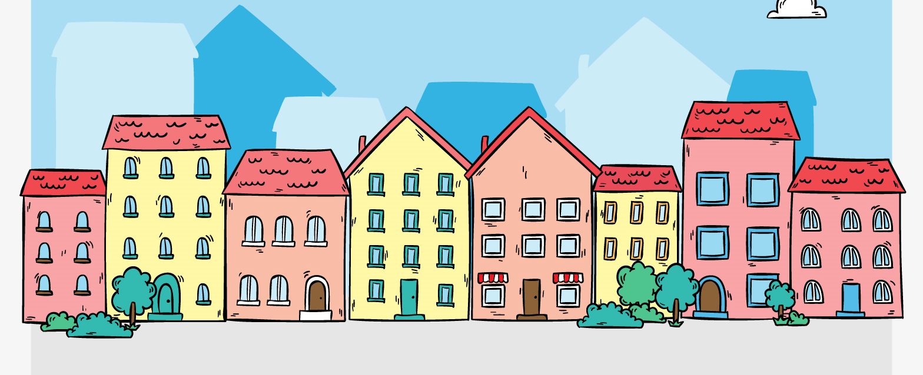
even
1
2
3
4
5
6
7
8
9
10
11

Slide 2
oneven
1
2
3
4
5
6
7
8
9
10
11

